Slide 1
Knowledge Discovery and Management - Class Project Sensor based Mobile Games for Healthy LIFE
Malathy Krishnan
PrAKASH REDDY

Slide 2
Video Highlights
Focus on Healthy life - Stay slim and trim !!
Fun playing games – burning calories
Regular exercise by playing games on mobile

Slide 3
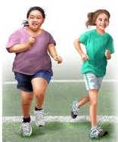
Project motivation
FACTS ABOUT OBESITY
one-third of U.S. adults (34.9%)
heart disease, stroke, type 2 diabetes and certain types of cancer
medical cost for obese people $1,429 higher than normal people.
affects 17% of all children and adolescents in US
Lack of daily, quality physical activity in all schools -only 33% attended daily physical activity.
Our project helps people overcome obesity
Makes the process fun for children and adults.

Slide 4

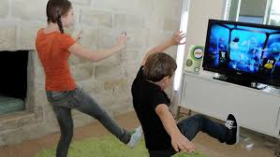
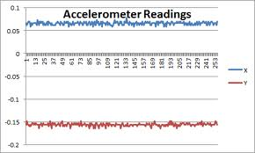
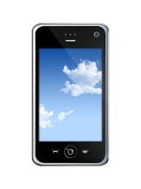
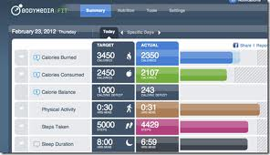
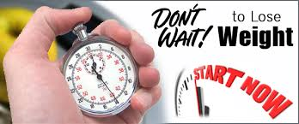
Project Idea
Machine learning
Physically Playing games
Collection of data
Report
Recommendation

Slide 5
Requirements
Mobile phone with the application installed
Sensor tag
Sensor tag pouch

Slide 6
CREATE your USERID

Slide 7
Sample Game FLuffY COW
Don’t Sit and touch your mobile to play
Need a healthy life??
Stand up and start stomping
Have fun playing!!!

Slide 8
Machine learning
Collects all the data form mobile through sensor
Find different actions using mahout
Saves in Solr

Slide 9
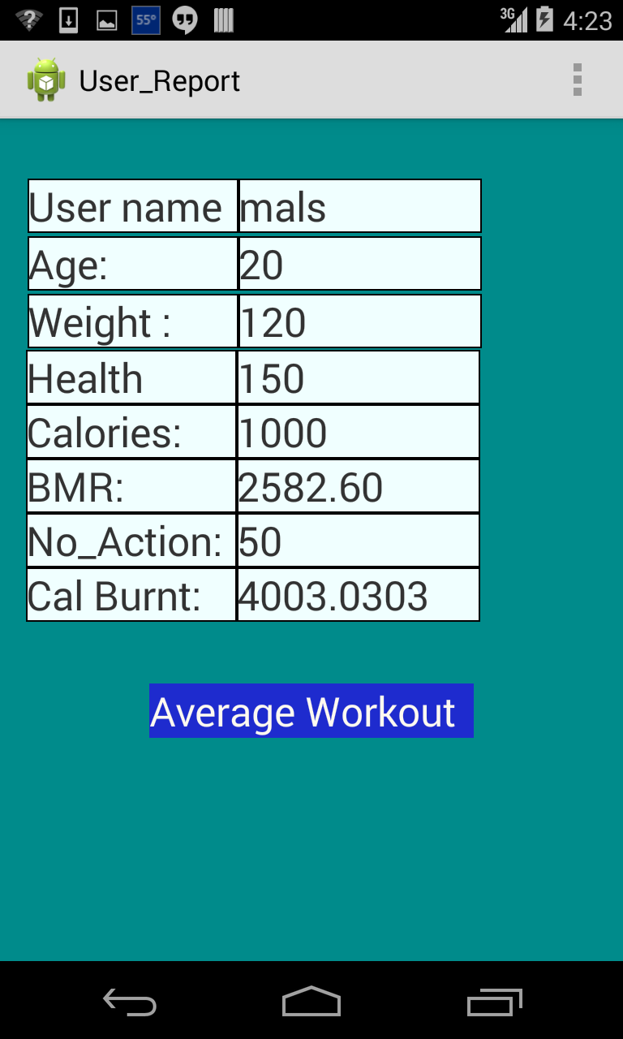
Report
Retrieves User’s details from Solr
Calculates the BMR
Gives the calorie burnt
Count of different motions
Workout Range – Less, Average, high

Slide 10
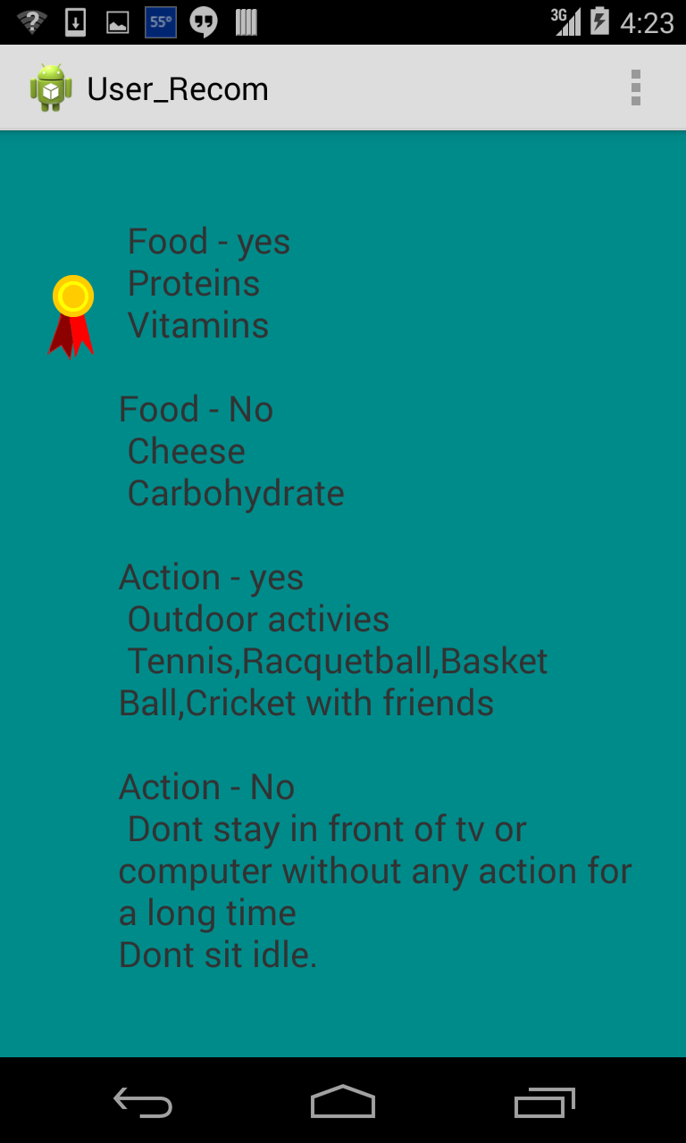
RECOMMANDATION
Food :
Eat
Avoid
Actions:
Do
Don’t

Slide 11
Achievements
No worries about obesity.
Find the calories burnt
Play game accordingly to maintain healthy life
fun activity and healthy body achieved together.

Slide 12
FUTURE
Integrating 2 player games.
Adding more game for different motions.
Using other sensor readings from sensor tags.
Playing online with friends.
Developing more Educational based games using sensors

Slide 13
GAME IDEAS
Science and Activity : Using sensors
Give activities like:
Find a place where temperature is 35F – 40F
Find a high pressure area in your surroundings
Sum of acceleration > 100G in 10 seconds
For kids:
Memory game :
Same images -> Stomp.
Else -> Kick

Slide 14
References

